Slide 1

A+ Guide to Hardware:
Managing, Maintaining, and Troubleshooting, 5e
Chapter 4
Supporting Processors

Slide 2
Objectives
Learn about the characteristics and purposes of Intel and AMD processors used for personal computers
Learn about the methods and devices for keeping a system cool
Learn how to install and upgrade a processor
Learn how to solve problems with the processor, the motherboard, overheating, and booting the PC
A+ Guide to Hardware

Slide 3
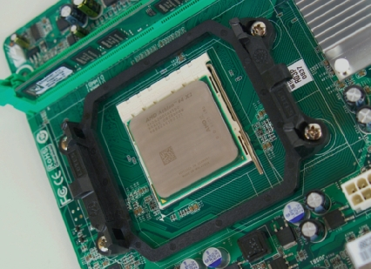
Types and Characteristics of Processors
Processor
  Installed on motherboard
  Determines system computing power
Two major processor manufacturers
  Intel and AMD
Figure 4-1 An AMD Athlon 64 X2 installed in socket AM2+ with cooler not yet installed
Courtesy: Course Technology/Cengage Learning
A+ Guide to Hardware

Slide 4
Types and Characteristics of Processors (cont’d.)
Features affecting processor performance and motherboards
  System bus speeds the processor supports
  Processor core frequency
  Motherboard socket and chipset
  Multiprocessing ability
  Memory cache
  Amount and type of DDR, DDR2, DDR3 memory
  Computing technologies the processor can use
  Voltage and power consumption
A+ Guide to Hardware

Slide 5
How a Processor Works
Three basic components
  Input/output (I/O) unit
    Manages data and instructions entering and leaving the processor
  Control unit
    Manages all activities inside the processor
  One or more arithmetic logic units (ALUs)
    Performs all logical comparisons, calculations
A+ Guide to Hardware

Slide 6
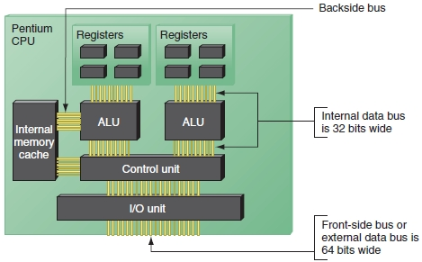
Figure 4-2 Since the Pentium processor was first released in 1993, the standard has been for a processor to have two arithmetic logic units so that it can process two instructions at once
Courtesy: Course Technology/Cengage Learning
A+ Guide to Hardware

Slide 7
How a Processor Works (cont’d.)
Registers
  Small holding areas on processor chip
    Holds counters, data, instructions, and addresses ALU is currently processing
Processor internal memory caches (L1, L2, L3)
  Holds data and instructions to be processed by ALU
Busses
  Front-side bus (FSB)
  Internal
  Back-side bus (BSB)
A+ Guide to Hardware

Slide 8
How a Processor Works (cont’d.)
Processor frequency (speed)
  Speed at which processor operates internally
Multiplier
  Factor multiplied against system bus frequency
    Determines processor frequency
  System bus frequency × multiplier = processor frequency
Motherboard firmware
  Automatically detects processor speed, adjusts system bus speed accordingly
A+ Guide to Hardware

Slide 9
How a Processor Works (cont’d.)
Overclocking
  Running motherboard or processor at higher speed than manufacturer suggests
  Override default frequencies
    Change setting in BIOS setup
  Disadvantages
    Overheating
    Voids most warranties
    Not recommended in business environment
A+ Guide to Hardware

Slide 10
How a Processor Works (cont’d.)
Throttling
  Offers some protection against overheating
    Throttle down, shut down system prevents permanent processor damage
  Reduces power consumption when demands low
  PowerNow! by AMD
  Enhanced Intel SpeedStep Technology (EIST) by Intel
A+ Guide to Hardware

Slide 11
How a Processor Works (cont’d.)
Three methods to improve performance
  Multiprocessing
    Processor contains more than one ALU
  Multiple processors
    Installing more than one processor on a motherboard
  Multi-core processing
    Processor housing contains two or more cores operating at same frequency, independently of each other
    Dual core, triple core, quad core, octo core
A+ Guide to Hardware

Slide 12
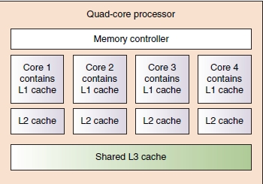
Figure 4-4 Quad-core processing with L1, L2, and L3 cache and the memory controller within the processor housing
Courtesy: Course Technology/Cengage Learning
A+ Guide to Hardware

Slide 13
How a Processor Works (cont’d.)
Memory cache (L1, L2, or L3)
  Holds anticipated data and instructions needed by controller
  Improves performance
  Static RAM (SRAM)
    Holds data as long as power on
    Lets processor bypass slower dynamic RAM (DRAM)
Memory controller
  Included in processor package
  Significant increase in system performance
A+ Guide to Hardware

Slide 14
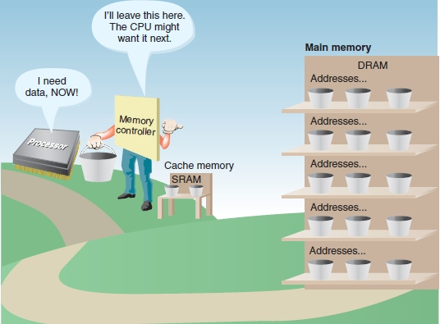
Figure 4-5 Cache memory (SRAM) is used to temporarily hold data in expectation of what the processor will request next
Courtesy: Course Technology/Cengage Learning
A+ Guide to Hardware

Slide 15
How a Processor Works (cont’d.)
Instruction set
  Microcode used for basic operations
Processor computing technologies
  MMX (Multimedia Extensions) and SSE (Streaming SIMD Extension)
  3DNow! and SSE2
  Intel Hyper-Threading and AMD HyperTransport
  PowerNow! and Cool’n’Quiet
  Enhanced Intel SpeedStep Technology (EIST)
  Execute Disable Bit
  32-bit and 64-bit instructions, operating systems
A+ Guide to Hardware

Slide 16
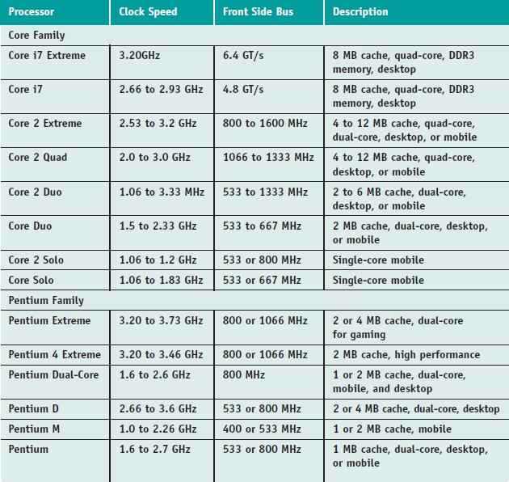
Intel Processors
Table 4-1 Current Intel processors
A+ Guide to Hardware

Slide 17
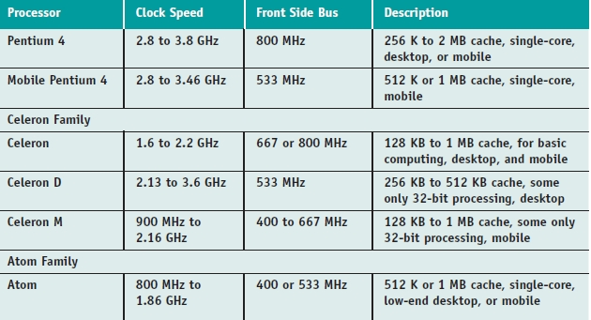
Intel Processors (cont’d.)
Table 4-1 Current Intel processors (continued)
A+ Guide to Hardware

Slide 18
Intel Processors (cont’d.)
Processor identification
  Processor number
    Example: Core 2 Quad processors
    Use five-character value beginning with “Q”
  eSpec number printed on processor
    Intel Processor Spec Finder site identifies exact processor
Centrino technology improves laptop performance
  Processor, chipset, wireless network adapter interconnected as a unit
A+ Guide to Hardware

Slide 19
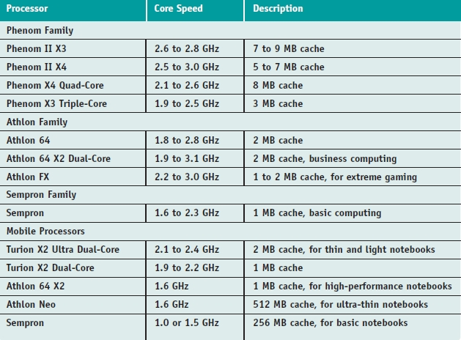
AMD Processors
Table 4-2 Current AMD processors
A+ Guide to Hardware

Slide 20
Cooling Methods and Devices
Processor overheating results
  Processor damage and instability
Entire system overheating results
  Sensitive electronic component damage
Devices used to keep system cool
  CPU fans, case fans, coolers, heat sinks, liquid cooling systems, dust-preventing tools
Important
  Keep processor and entire system cool
A+ Guide to Hardware

Slide 21
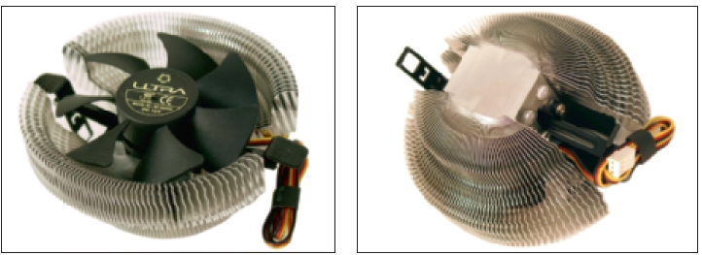
Coolers, Fans, and Heat Sinks
Cooler sits on top of processor
    Maintains 90–110 degrees F temperature
  Consists of fan, heat sink
  Made of aluminum, copper, combination of both
  Bracketed to motherboard using wire, plastic clip
  Thermal compound eliminates air pockets
  Fan power cord connects to 4-pin fan header
Figure 4-9 A cooler sits on top of a processor to help keep it cool
Courtesy: Course Technology/Cengage Learning
A+ Guide to Hardware

Slide 22
Coolers, Fans, and Heat Sinks (cont’d.)
Figure 4-9 A cooler sits on top of a processor to help keep it cool
Courtesy: Course Technology/Cengage Learning
A+ Guide to Hardware

Slide 23
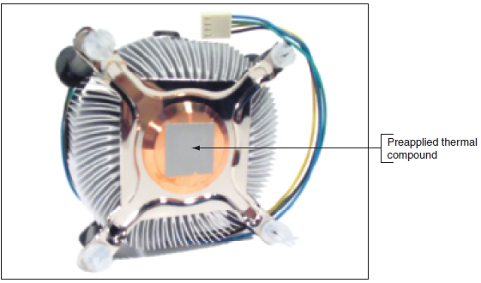
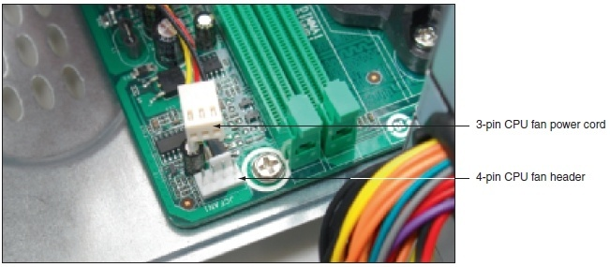
Figure 4-11 Thermal compound is already stuck to the bottom of this cooler that was purchased boxed with the processor
Courtesy: Course Technology/Cengage Learning
Figure 4-12 A cooler fan gets its power from a 4-pin PWM header on the motherboard
Courtesy: Course Technology/Cengage Learning
A+ Guide to Hardware

Slide 24
Case Fans and Other Fans and Heat Sinks
Rear case fan draws air out of the case
  High-end systems have seven or eight fans
BTX form factor: fewer fans required
Ball-bearing case fans last longer
Cooling graphic cards
  Some come with with fan on side
  Heat sinks or fans to mount on card may be used
  Fan card mounted next to graphics card may be used
  For additional cooling consider a RAM cooler
A+ Guide to Hardware

Slide 25
Liquid Cooling Systems
Exotic systems hobbyists use for overclocking
  Refrigeration
    Units containing small refrigerator compressor inside case
    Can reduce temperatures to below zero
  Peltiers
    Heat sink carrying an electrical charge
    Acts as an electrical thermal transfer device
  Water coolers (most popular)
    Small pump sits inside computer case
    Tubes move liquid around components and away from them where fans cool the liquid
A+ Guide to Hardware

Slide 26
Dealing with Dust
Dust insulates PC parts like a blanket
  Causes overheating
Dust inside fans
  Jams fans, causing overheated system
Ridding PC of dust
  Make it a part of regular preventive maintenance
  Tools
    Antistatic vacuum
    Compressed air
A+ Guide to Hardware

Slide 27
Selecting and Installing a Processor
PC repair technician tasks
  Assemble PC from parts
  Exchange faulty processor
  Add a processor
  Upgrade existing processor
Must know how to:
  Match processor to system
  Install processor on motherboard
A+ Guide to Hardware

Slide 28
Select a Processor to Match System Needs
First requirement
  Select processor motherboard is designed to support
Select best processor meeting general system requirements and user needs
  May have to sacrifice performance for cost
General steps
  Read motherboard documentation
  Select processor by comparing processors board supports
  Select cooler assembly
A+ Guide to Hardware

Slide 29
Install a Processor
Installing an Intel processor in socket 1366
  1. Read and follow all directions
  2. Use a ground bracelet
  3. Open the socket
  4. Lift socket load plate
  5. Remove socket protective cover
  6. Remove processor protective cover
  7. Lower processor straight down into the socket
  8. Verify processor aligned correctly in the socket
  9. Return lever to its locked position
A+ Guide to Hardware

Slide 30
Install a Processor (cont’d.)
Installing an Intel processor in socket 1366 (cont’d.)
  General steps to install the cooler
    Understand how cooler posts work
    Apply thermal compound if necessary
    Verify locking pins turned perpendicular to heat sink
    Align cooler over the processor
    Push down on each locking pin until it pops into the hole
    Connect power cord from cooler fan to motherboard
  Check BIOS setup to verify the system recognized processor after system up and running
A+ Guide to Hardware

Slide 31
Install a Processor (cont’d.)
Installing an Intel processor in socket 775
  Socket 775 has a lever and socket cover
  Summary of installation steps
    1. Use ground bracelet, read all directions
    2. Release lever from the socket, lift socket cover
    3. Place processor in the socket
    4. Close the socket cover
    5. Apply thermal compound and install cooler
    6. Connect fan power cord to power connection
  After components installed, verify system works
A+ Guide to Hardware

Slide 32
Install a Processor (cont’d.)
Installing an Intel processor in socket 478
  Similar to socket 775 installation
  Summary of installation steps
    1. Open the socket, open the load plate, carefully install the processor, return lever to its position
    2. Apply thermal compound and install cooler
    3. Connect fan power cord to power connection
  After components installed, verify system works
A+ Guide to Hardware

Slide 33
Install a Processor (cont’d.)
Installing an AMD processor in socket AM2+
  Summary of installation steps
    1. Use ground bracelet, read all directions
    2. Open the lever
    3. Place processor in the socket
    4. Verify processor pins sitting slightly into the holes
    5. Press the lever down and gently into position
    6. Apply thermal compound and install cooler
    7. Connect fan power cord to power connection
  After components installed, verify system works
A+ Guide to Hardware

Slide 34
BIOS Power Management Settings for the Processor
Advanced Configuration and Power Interface (ACPI)
  Current power management standards
    Used by BIOS, hardware, and OS
  Four modes indicate power-saving function levels
    S1 state: hard drive, monitor turned off and everything else runs normally
    S2 state: hard drive, monitor, processor turned off
    S3 state: everything shut down except RAM and enough of the system to respond to a wake-up call
    S4 state: everything in RAM copied to hard drive file, then system shuts down (hibernation)
A+ Guide to Hardware

Slide 35
BIOS Power Management Settings for the Processor (cont’d.)
ACPI defines CPU P states
  Saves power by lowering CPU frequency, voltage
  P0 has highest frequency
    Higher P state values have lower frequencies
  EIST, PowerNow!
    Implements P states if enabled in BIOS setup
    If enabled in BIOS, P states are controllable by Windows power management
A+ Guide to Hardware

Slide 36
BIOS Power Management Settings for the Processor (cont’d.)
ACPI defines C states
  Processor stops its internal operations
    Conserves power
  C0 state: processor can execute an instruction
  C1 though C6 states
    Processor shuts down various internal components
  Deeper the C state, the longer it takes for processor to wake up
  Mobile processors usually offer more C states than desktop processors
  Feature must be enabled in BIOS
A+ Guide to Hardware

Slide 37
Troubleshooting the Motherboard and Processor
Motherboard field replaceable units (FRUs)
  Processor
  Processor cooler assembly
  RAM
  CMOS battery
  Motherboard
Be careful when substituting good hardware components for those suspected to be bad
A+ Guide to Hardware

Slide 38
Problems with Installations
Check simple things first
  Verify motherboard supports processor
  Check cooling fan installation
  Remove processor, examine, reinstall
  Reinstall old processor, flash BIOS, install new processor
Check other system items
  System and monitor plugs, peripheral connections
  Case door closure, power switches, voltage
  OS drivers
  Various motherboard connections
A+ Guide to Hardware

Slide 39
Problems with the Motherboard or Processor
Use BIOS jumpers to reset passwords
Verify CMOS battery
  Replace if necessary
Symptoms of failing motherboard or processor
  System begins to boot, then powers down
  Error message displayed during boot
  System unstable, hangs, freezes at odd times
  Intermittent Windows or hard drive errors occur
  Motherboard components or connected devices do not work
A+ Guide to Hardware

Slide 40
Problems with the Motherboard or Processor (cont’d.)
Check the simple things first
  Review power saving features
  Look at applications or OS
  Look at power cords, hard drives, overheating, failed RAM, power supply
  Reduce system to essentials
    Remove unnecessary hardware
    See if problem resolved
A+ Guide to Hardware

Slide 41
Problems with the Motherboard or Processor (cont’d.)
Hanging system problem persists
  Assume processor or motherboard at fault
    Verify solid installation of components and connectors
    Check BIOS setup, allow BIOS to report on full POST
    Flash BIOS to update firmware
    Look for physical damage
    Run diagnostic tests from motherboard CD
    Update board component drivers
    Disable failed components
    Verify motherboard supports processor
    Exchange processor or motherboard
A+ Guide to Hardware

Slide 42
Problems with Overheating
Temperature inside case
  Never exceed 100 degrees F (38 degrees C)
  Tools to monitor operating temperature
    BIOS readings, temperature sensor, utility software
  Symptoms of system overheating
    System hangs, freezes at odd times, or a few moments after boot starts
    Windows error during boot (blue screen of death)
    Cannot hear fan running or fan makes whining sound
    Cannot feel air being pulled into or out of the case
A+ Guide to Hardware

Slide 43
Problems with Overheating (cont’d.)
Simple things to solve overheating problems
  Verify temperature in BIOS
  Remove dust
  Check airflow inside case
  Install additional fans, chassis air guide (if possible)
  Replace missing faceplates and slot covers
  Verify cables and cooler connection
  Allow case to breath
  Check for overclocking and too many peripherals
  Flash BIOS or replace thermal compound
A+ Guide to Hardware

Slide 44
Problems with Overheating (cont’d.)
More drastic solutions
  Consider case design
    Use power supply with vents on bottom and front
    Use intake fan on case front to pull air into the case
    Use a chassis air guide (CAG)
A+ Guide to Hardware

Slide 45
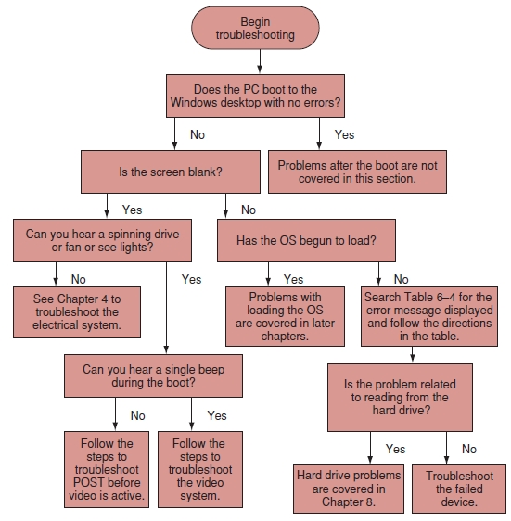
Boot Problems Before the Operating System Loads
Figure 4-56 Use this flowchart when first facing a computer problem
Courtesy: Course Technology/Cengage Learning
A+ Guide to Hardware

Slide 46
Boot Problems Before the Operating System Loads (cont’d.)
Troubleshooting POST before video active
  Error messages on screen
    Indicates video and electrical system working
  For blank screen, listen to beep codes
    If no beeps are heard suspect other components
A+ Guide to Hardware

Slide 47
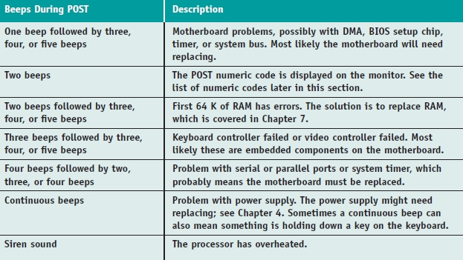
Table 4-3 Beep Codes and Their Meanings
A+ Guide to Hardware

Slide 48
Boot Problems Before the Operating System Loads (cont’d.)
Troubleshooting video
  If one beep during boot and a blank screen:
    BIOS successfully completed POST including test of video card
  Possible monitor problem
    Is monitor electrical cable plugged in?
    Is monitor turned on?
    Is monitor cable plugged into video port?
    Try a different monitor, monitor cable
A+ Guide to Hardware

Slide 49
Boot Problems Before the Operating System Loads (cont’d.)
Troubleshooting error messages during boot
Error message sources
  After video active
    Hardware device failed POST
  After POST
    Startup BIOS turned to hard drive to find an OS
    Could not read from drive
  After BootMgr or Ntldr in control
    Could not find OS files to load the OS
A+ Guide to Hardware

Slide 50
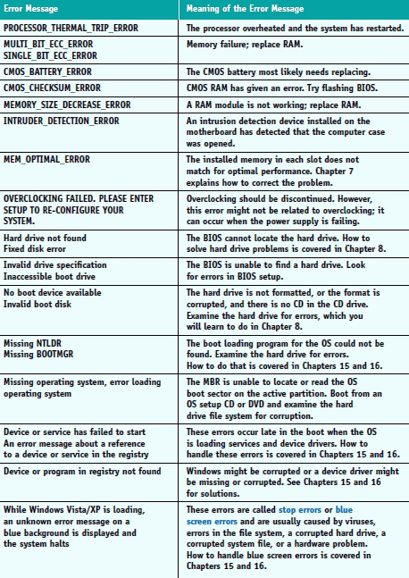
Table 4-4 Error Messages and Their Meanings
A+ Guide to Hardware

Slide 51
Summary
Processor: most important motherboard component
  Basic CPU components: I/O unit, control unit, ALUs
  Registers: high speed memory used by ALU
  Internal cache: holds frequently used instructions
  CPU bus: internal and external
Overclocking
  Running system bus or processor at a faster frequency than recommended
Throttling offers some protection against overheating
A+ Guide to Hardware

Slide 52
Summary (cont’d.)
Multiprocessing, multiple processors, and multi-core processing improve CPU performance
Memory cache (L1, L2, or L3)
  Holds anticipated data and instructions
  Made of static RAM chips
Instruction set
  Microcode used for basic operations
Various Intel and AMD processors available
Many cooling options available
Match processor to system, install and troubleshoot
A+ Guide to Hardware

